Slide 1
Жизнь и проблемы подростков.
Презентацию выполнил учитель английского языка Манюк А.Н.

Slide 2
Цели и задачи:
1) Развивать лексические навыки говорения.
2) Практиковать учащихся в аудировании.
3)Развивать умение интерпретировать статические таблицы и средства графической наглядности.
Метод: интерактивный
Тип:обучающий

Slide 3

rebellion - бунтарский
to reject-отвергать
Violenсе-насилие
Addiction-зависимость
to arrest-арестовать
Harm-вред, ущерб
View-взгляд
Age limits-возр.ограничение
to allow-разрешать
to forbid-запрещать
to let-позволить
to permit-разрешать
to complain-жаловаться

Slide 4

Problems Of Teenagers In Russia And English-speaking Countries.

Slide 5

Teenagers’ life
There are many people but you feel alone. You want to do what you want But your parents say when to come home. You want to be a grown-up But on the other hand you miss your childhood. You are allowed to do so many new things But there is the fear of decisions and responsibility. You laugh, you cry, you keep quiet, you want to sing. Sometimes you can’t explain what you feel.
Those are problems of TEENAGES’ LIFE. Sometimes it’s really great but it also can be as hard as a knife.

Slide 6
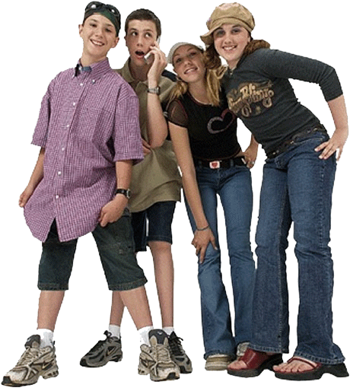
Who Is a Teenager?
A teenager is a boy or a girl in his or her teens or up to 21 or 22 years of age.

Slide 7

Teens age is the most beautiful period of life as young people usually experience their first great love and they have many friends. And they are sure they will have a long and happy life. But at the same time it is the most difficult period, as teenagers have many problems and it makes a process of becoming a teenager very difficult. Nowadays, it's not very easy to adapt to hardships as quickly as they happen. Teen years can be very stressful.

Slide 8




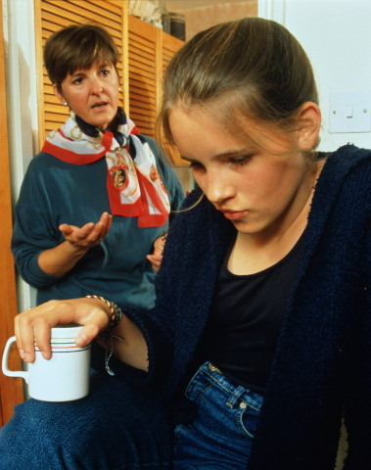
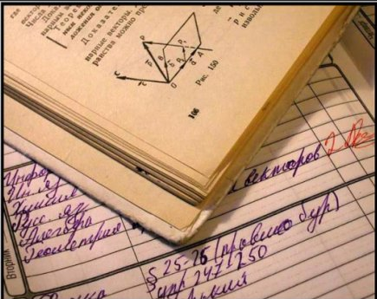
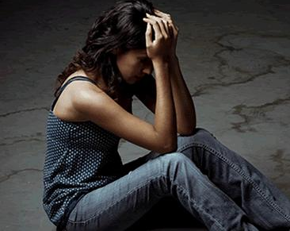
Widespread Problems
School problems
aggression
Teen depression
Health problems
Family problems
obesity
Emotional problems
Personal
problems

Slide 9
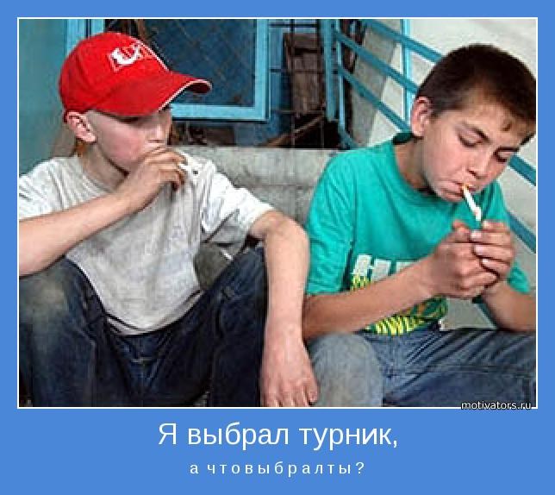
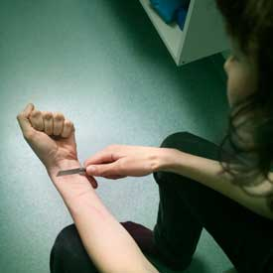
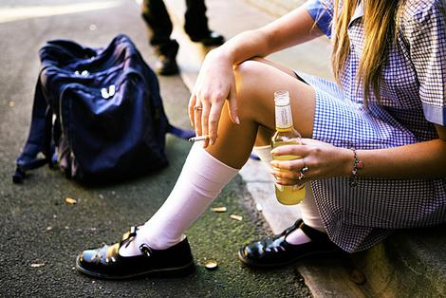
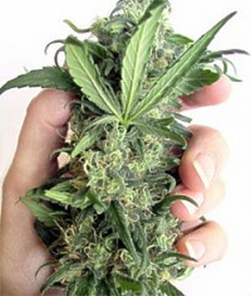
Dangerous Problems
Smoking tobacco
Teen suicide
Taking drugs
alcoholism

Slide 10

Social Survey
problems of communication with classmates
problems with teachers
problems with parents
problem of shortage of free time
unhappy love
depressions
smoke
alcohol
drugs

